Slide 1

TechNightCSI_hackathon
By TEAM One-piece

Slide 2
Intro of member of One-piece
Myself:- Harshit Kandpal
2nd member:- Aarya Kamble

Slide 3
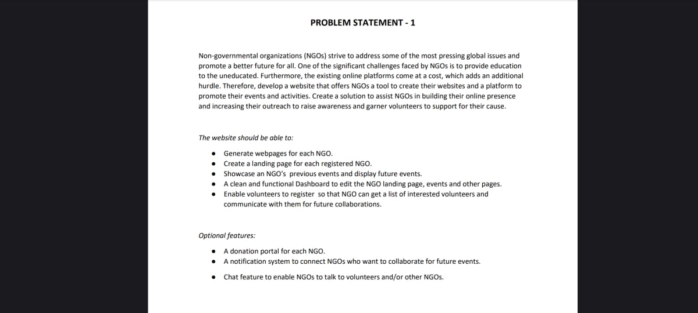
Domain: Web Development

Slide 4
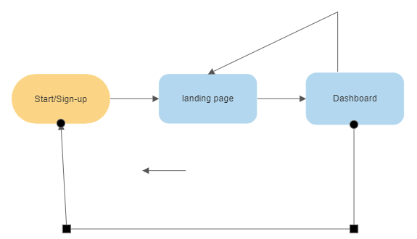
Solution
Workflow

Slide 5
Desktop view

Slide 6

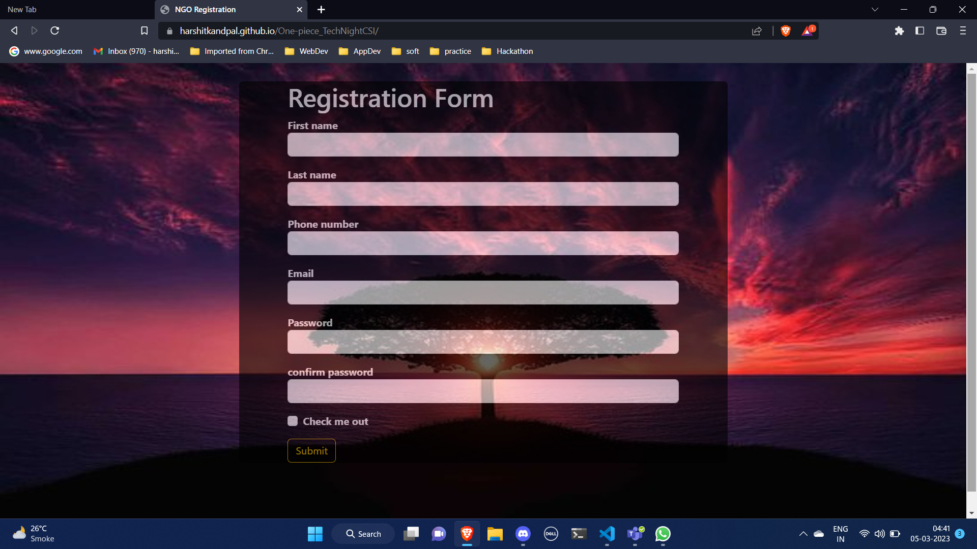
REGISTERATION PAGE
This site is a standard registration page for volunteers.
https://harshitkandpal.github.io/One-piece_TechNightCSI/

Slide 7
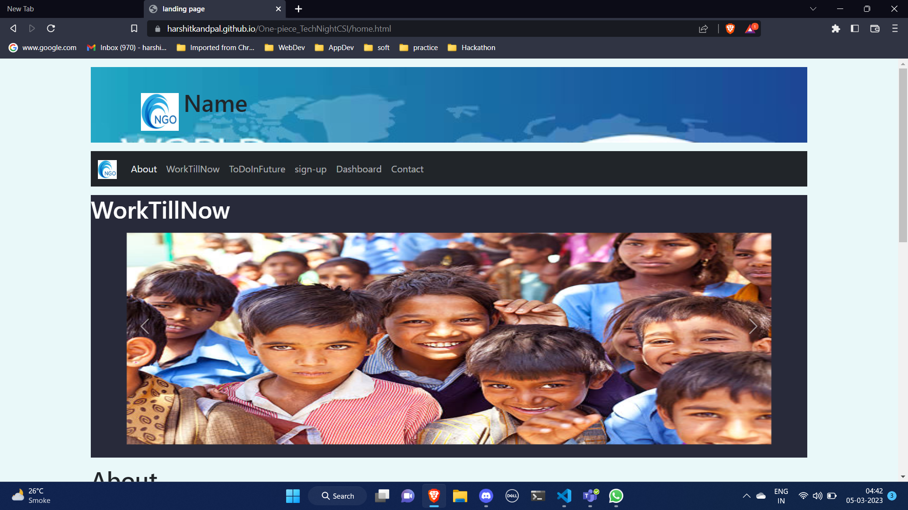

Slide 8
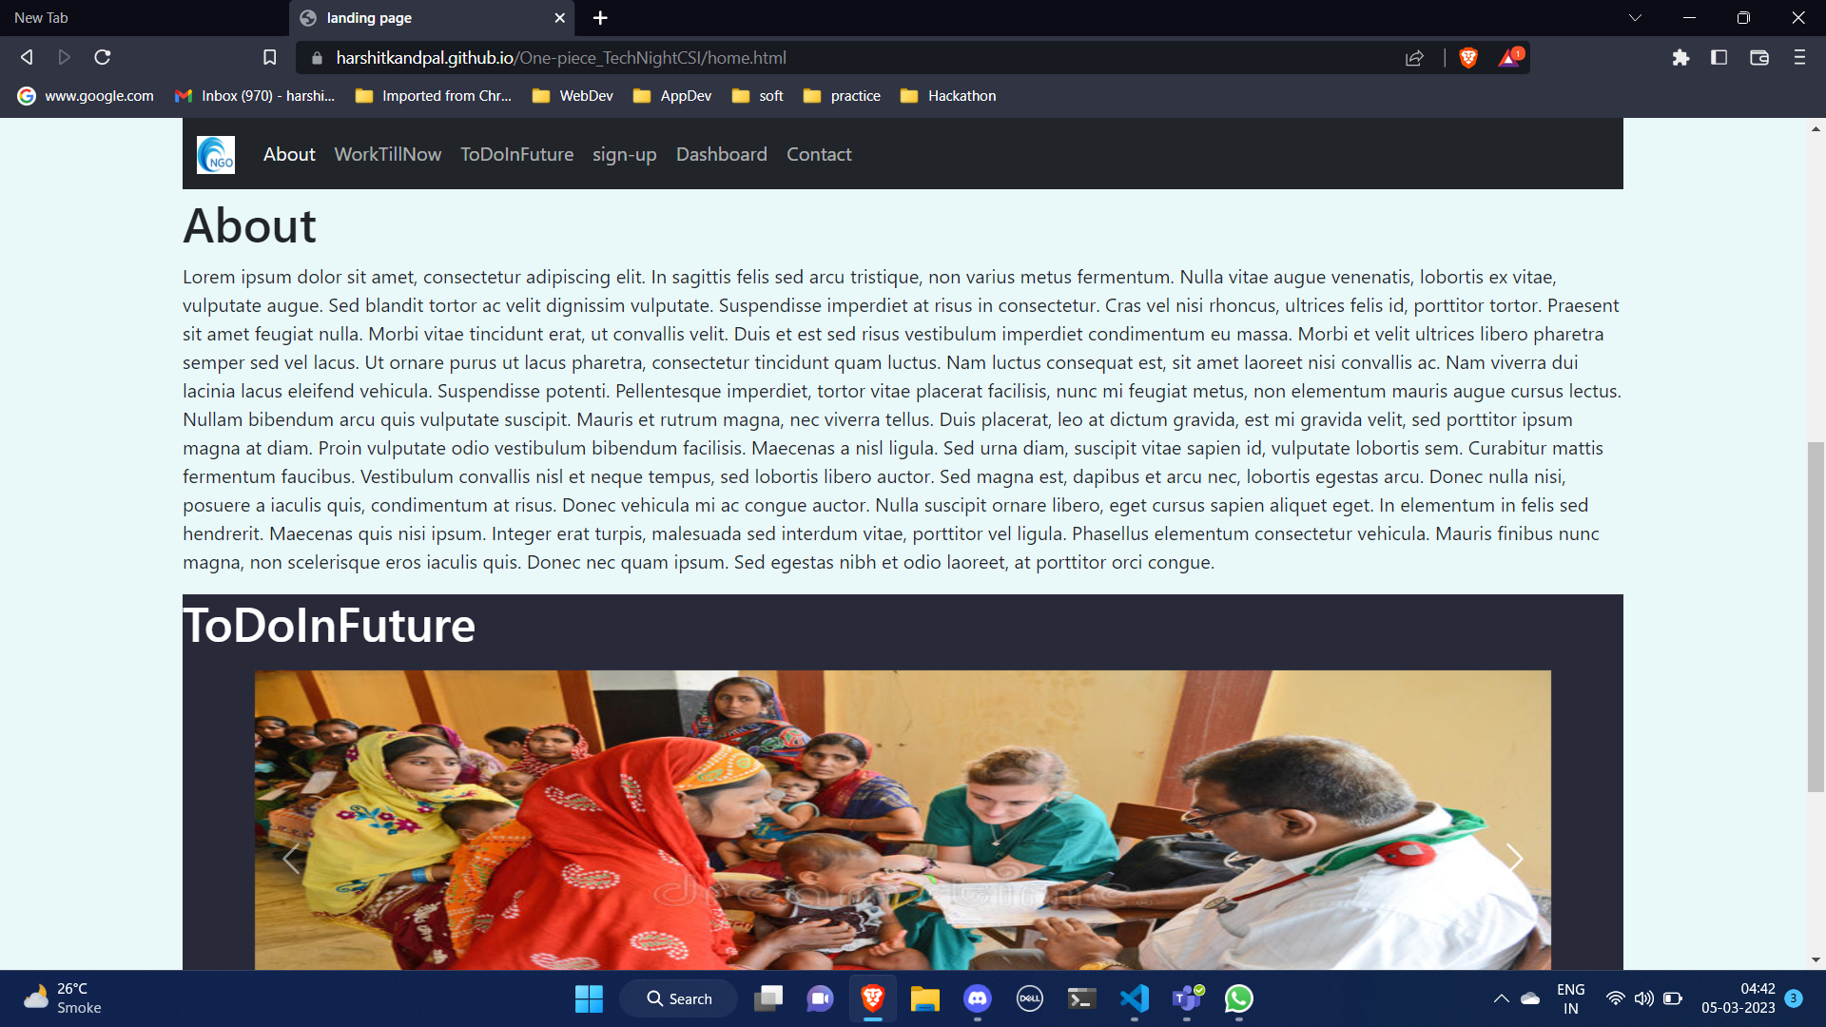

Slide 9
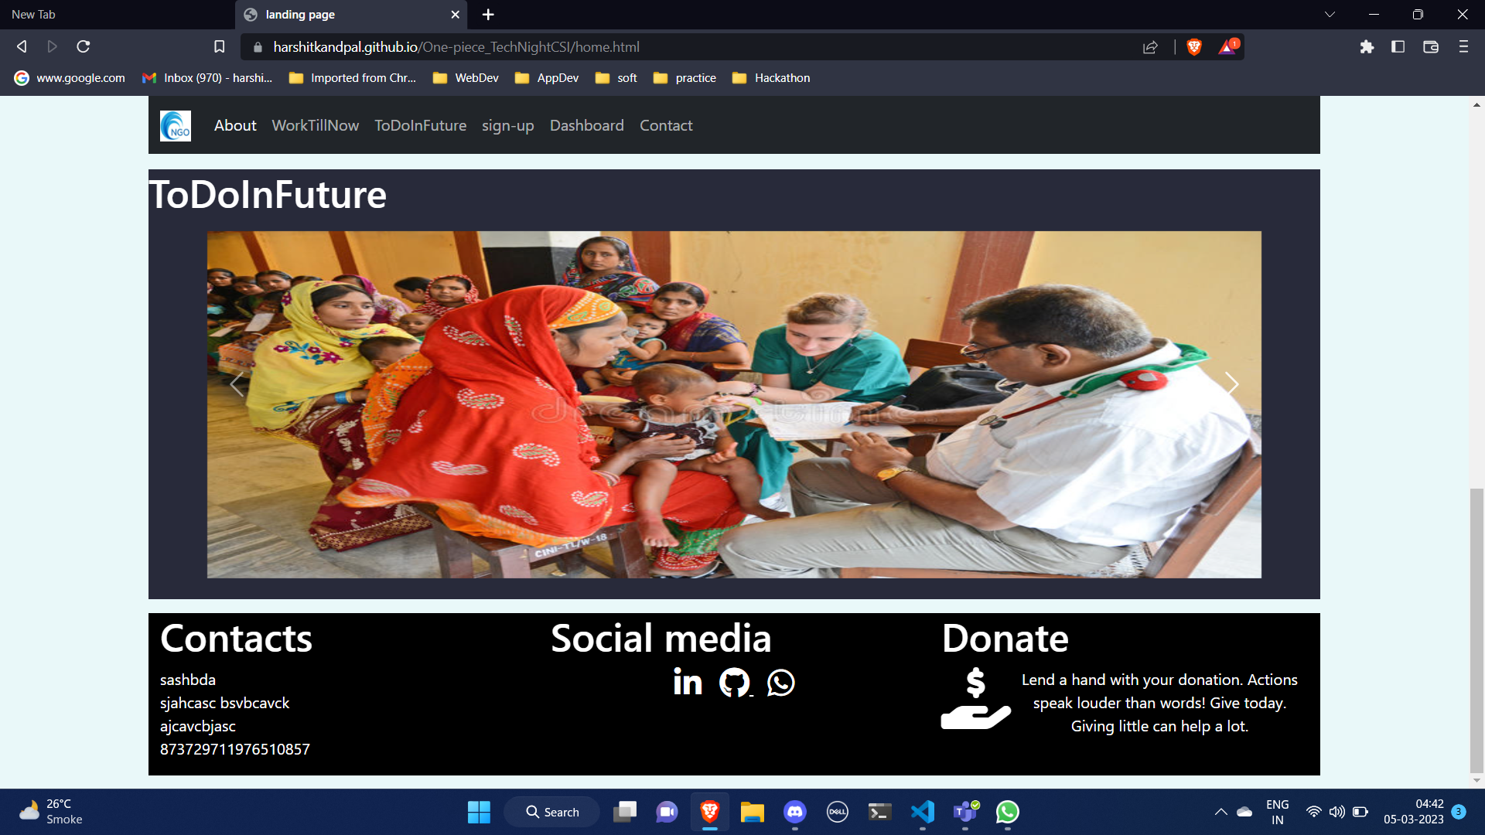

Slide 10
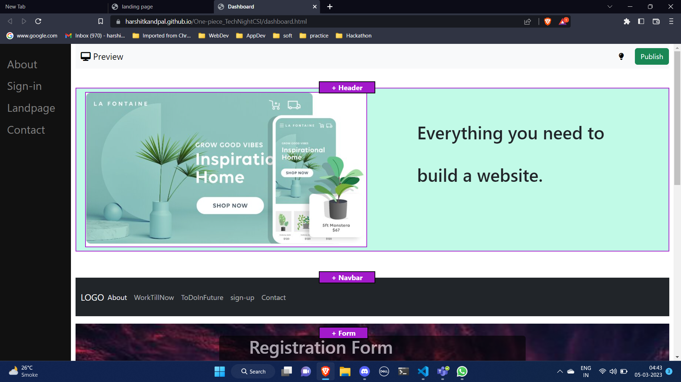

Slide 11
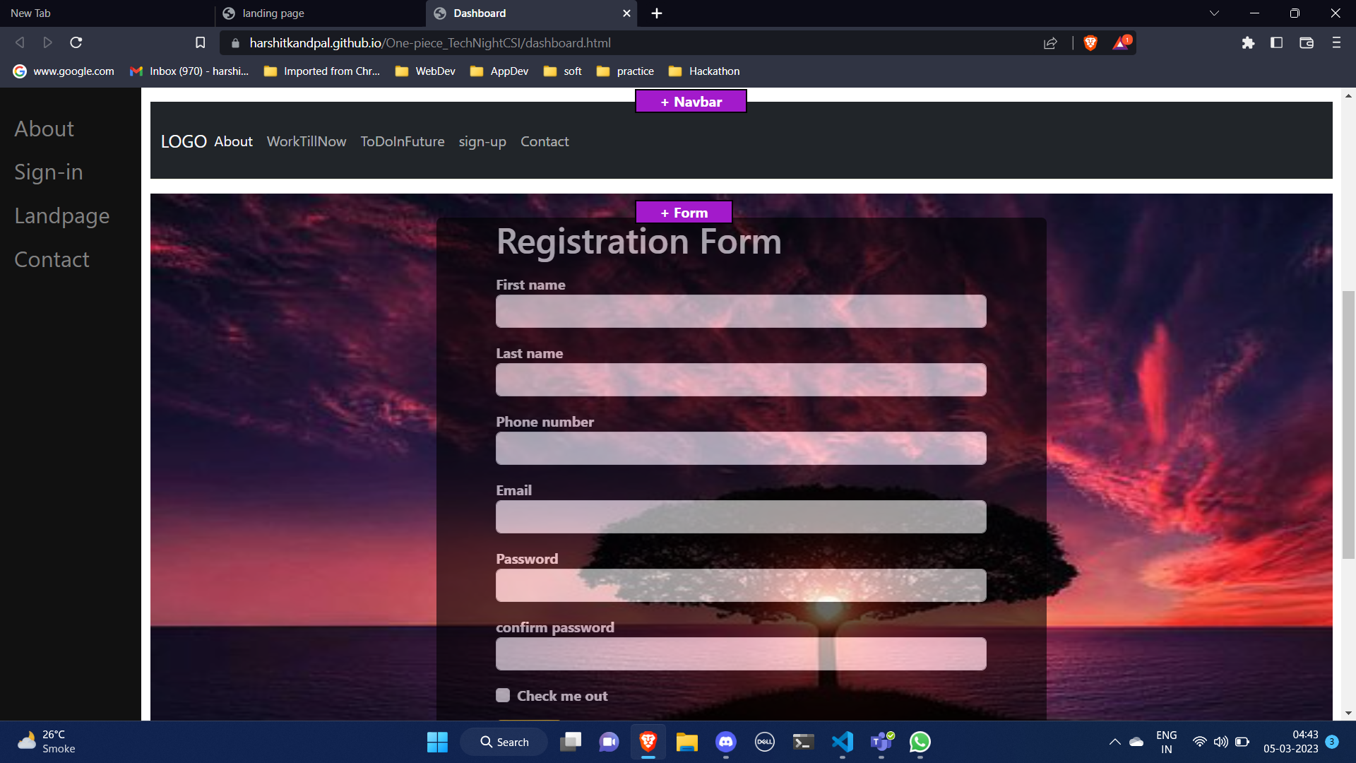

Slide 12
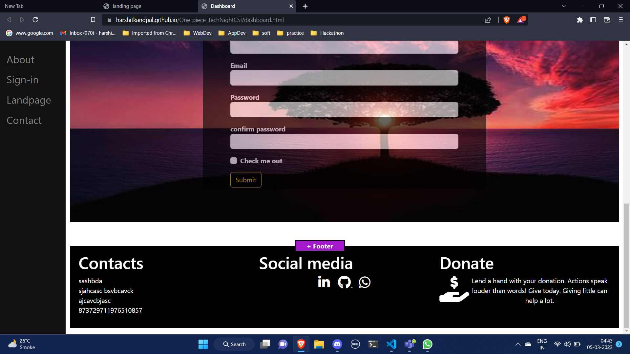

Slide 13
Mobile view

Slide 14
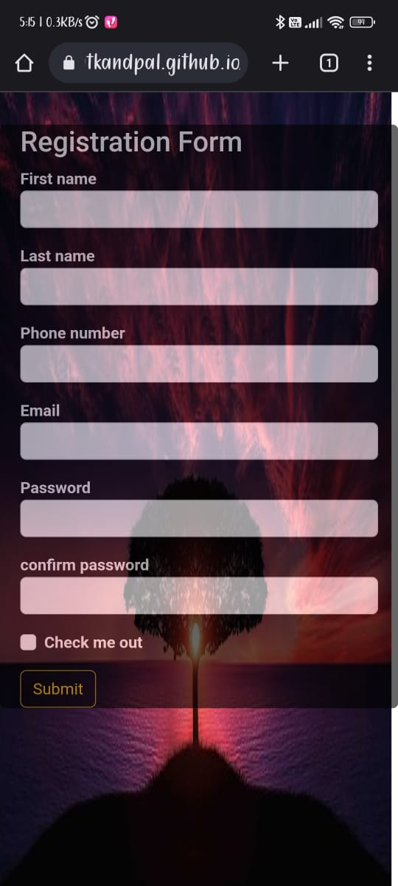

Slide 15
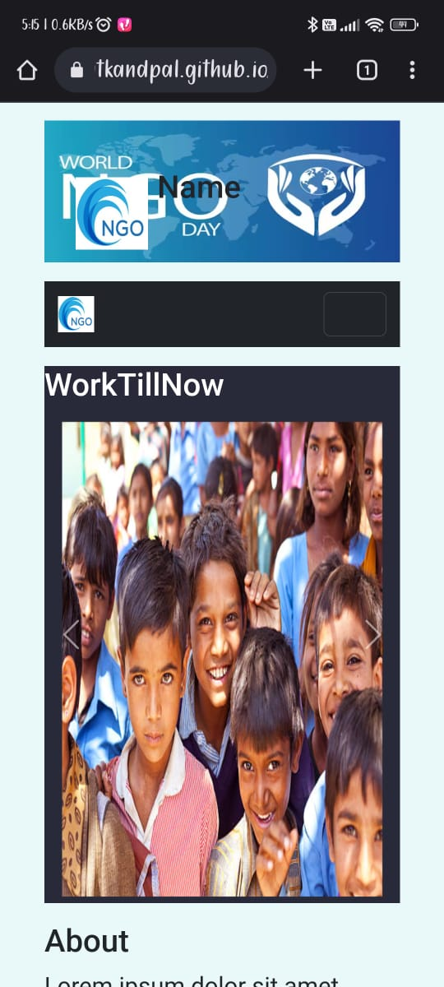

Slide 16
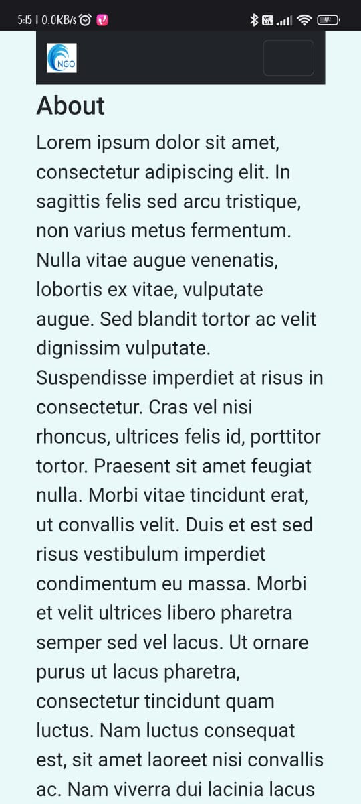

Slide 17
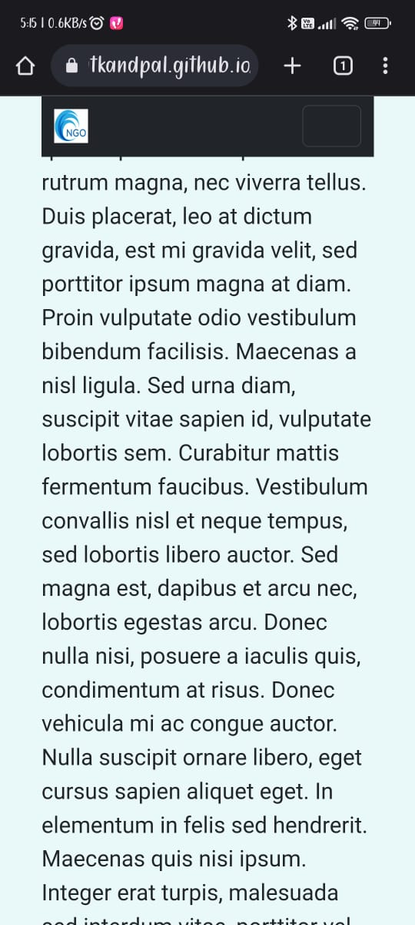
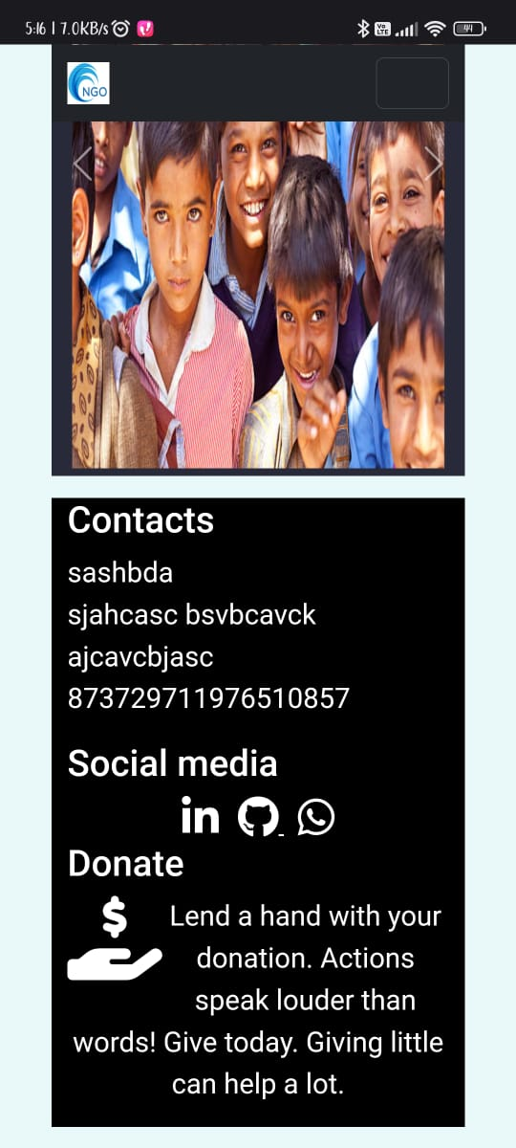

Slide 18
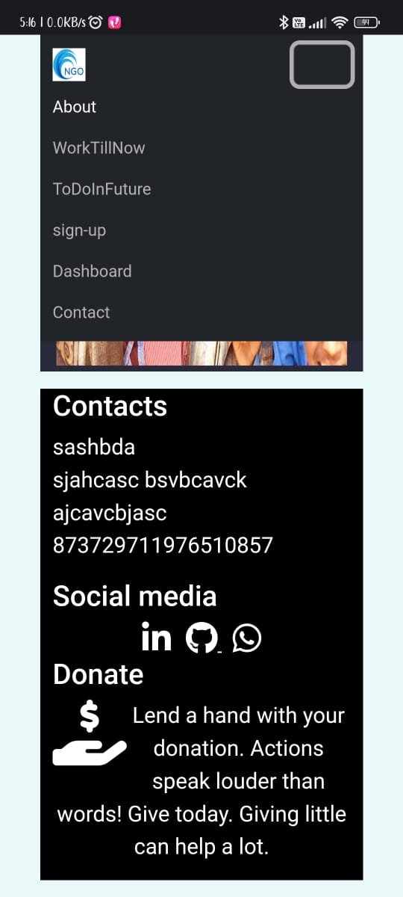

Slide 19
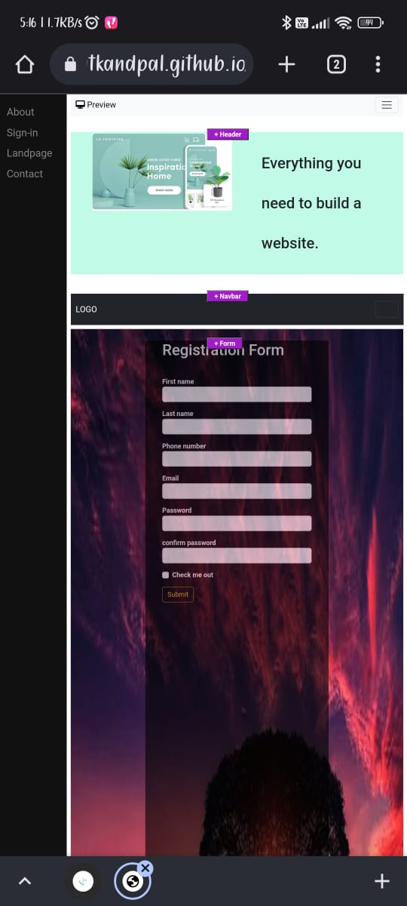

Slide 20
